Slide 1
Attacks via Tor
Intrusion Detection Module
Stephen Huang
Department of Computer Science
University of Houston

Slide 2
Overview
Introduction of Tor
Attack via Tor

Slide 3
Introduction of Tor
Low-latency, bandwidth-efficient, anonymizing layer for TCP streams.
With use of 3 nodes, no node knows the identities of both communicating parties.

Slide 4
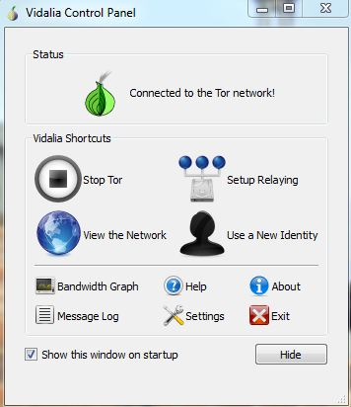

Tor Control Panel

Slide 5
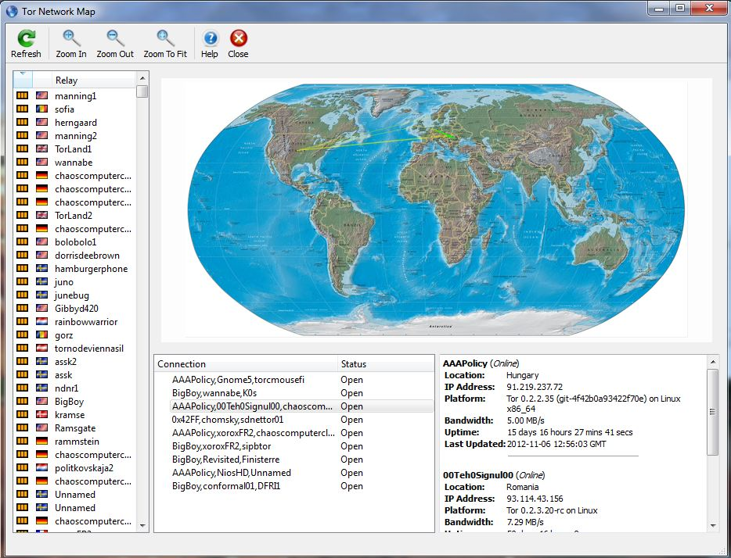
Tor Network Map

Slide 6
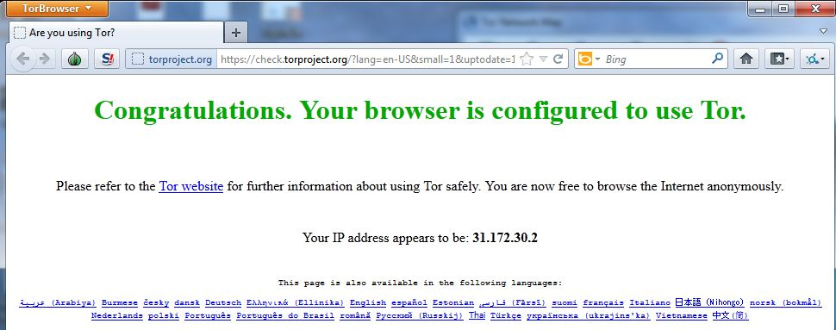
Portable Firefox Browser
31.172.30.2

Slide 7
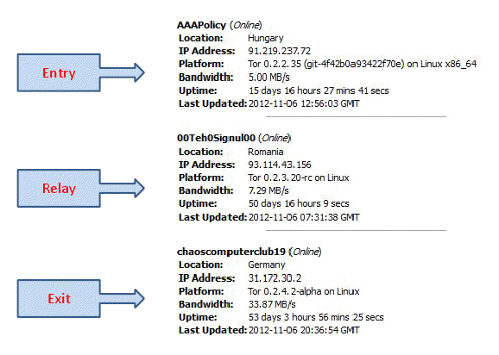
Circuit of Three Nodes

Slide 8
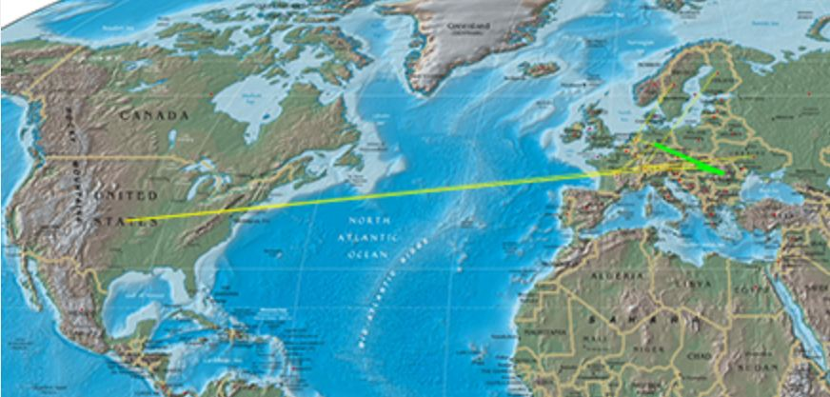
Graphic Circuit Routing Map

Slide 9
Tor Configuration
ExcludeNodes node,node,…
A list of identity fingerprints, nicknames, country codes and address patterns of nodes to avoid when building a circuit.
ExitNodes node,node,…
A list of identity fingerprints, nicknames, country codes and address patterns of nodes to use as exit node---that is, a node that delivers traffic for you outside the Tor network.
EntryNodes node,node,…
A list of identity fingerprints and nicknames of nodes to use for the first hop in your normal circuits.

Slide 10
Introduction of Tor
Attack via Tor

Slide 11
HTTP
Client
Server
Tor Client
Tor Entry
Tor Exit
Server
TCP SYN
TOR
Begin
{relay}
TCP SYN
TCP SYN-ACK
TCP ACK-ACK
Normal TCP GET delay
{relay}
TCP SYN-ACK
Connected
HTTP GET
TCP ACK-ACK
{relay}
HTTP GET
Tor GET delay
HTTP GET
(a) Normal TCP (b) Connection through Tor

Slide 12
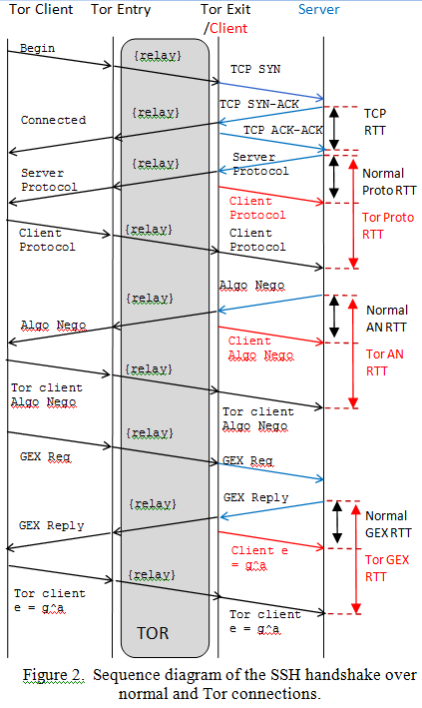

Slide 13
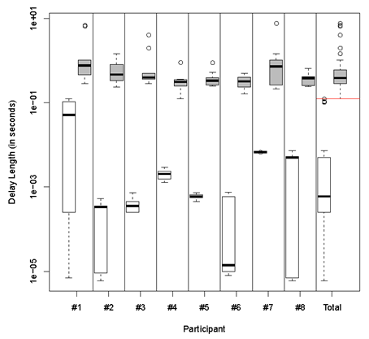

Slide 14
aprilnormProtoProp | 4.0325603 | 0.1948419 | 1.0768482 | 0.9269265
aprilnormKexProp | 1.0463026 | 0.1493332 | 0.8116702 | 0.7863191
aprilnormGexProp | 1.6425390 | 0.3764337 | 0.9913608 | 1.0664340
apriltorProtoProp | 5.3336868 | 21.3737604 | 5.0774953 | 14.4786318
apriltorKexProp | 2.8171449 | 2.1722424 | 2.2745978 | 3.2051499
apriltorGexProp | 5.8288520 | 13.0295240 | 3.4748304 | 12.9632918
bradnormProtoProp | 0.9705960 | 0.9700649 | 0.9771319 | 1.0538042
bradnormKexProp | 1.0009392 | 1.0048041 | 0.9288549 | 1.0044924
bradnormGexProp | 1.5113546 | 1.5938730 | 1.5226987 | 1.7021704
bradtorProtoProp | 13.6524243 | 34.5225518 | 4.9181900 | 5.6603084
bradtorKexProp | 4.0557379 | 3.2536943 | 0.9815891 | 1.2038587
bradtorGexProp | 15.2780213 | 12.2357742 | 3.2656419 | 4.3072628

Slide 15
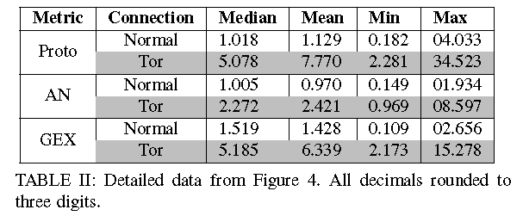

Slide 16
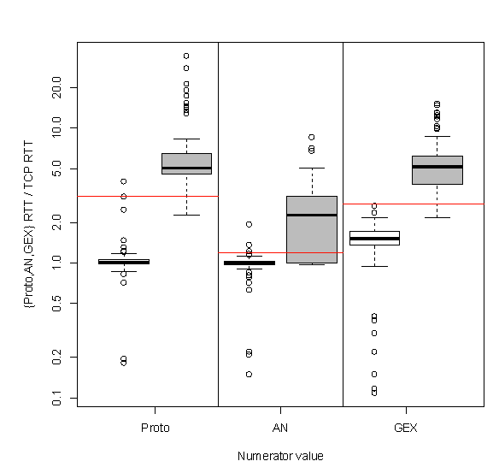

Slide 17
